Slide 1
SQL
September, 2016

Slide 2
Select and Group By
Joins
Inner Join
Outer Join
Self Join
Union
Indexes

Slide 3
SQL QUERY

Slide 4
DQL - SELECT
Select the rows from the table
SELECT [ALL|DISTINCT] select-list | *
FROM [table_list]
WHERE Column1=Value1 [, Column=Value1]
GROUP BY column-1 [,column-2] ...
HAVING <condition>
ORDER BY column-1 [ASC|DESC] [ column-2 [ASC|DESC] ] ...
DISTINCT selects distinct rows.
WHERE clause is used for filtering.
ORDER BY clause is used for sorting.
GROUP BY, HAVING explained in later slides.
Notes:
Database Client Server
FROM, WHERE clause filtering done on Server side
whereas
GROUP BY, HAVING, ORDER BY clause filtering and manipulating done on client side on the data received from server side.

Slide 5

DML – Using functions in SELECT clause
Number functions
ROUND
SELECT ROUND(376.339, 2 ) FROM dual;
376.34
TRUNC
SELECT TRUNC(376.339, 2 ) FROM dual;
376.33
MOD
SELECT MOD(1360,100) FROM dual;
60

Slide 6

DML – Using functions in SELECT clause
Types of functions
String functions
Conversion functions
Number functions
Aggregate functions
Other functions
Notes:
Database Client Server
FROM, WHERE clause filtering done on Server side
whereas
GROUP BY, HAVING, ORDER BY clause filtering and manipulating done on client side on the data received from server side.

Slide 7
DML – Using string functions in SELECT clause
Function | Description | Syntax
UPPER | Converts String to upper case letters. | Upper(String)
LOWER | Converts String to lower case letters. | Lower(String)
INITCAP | Capitalizes the first character of each word in the string | Initcap(String)
REPLACE | Replaces a pattern in the string with another pattern. | Replace(String, old_pattern, new_pattern)
SUBSTR | Extracts the number of characters from a string from a given starting position. | Substr(String, start_position, no_of_chars)
INSTR | Returns the position if a specified pattern is present in the string else returns zero. | Instr(String, pattern)
TRIM | Removes leading and trailing spaces from a string | Trim(String)
LENGTH | Gives a count of characters present in the string | Length(String)
CONCAT | Joins two strings as a single string. | Concat(String1, String2)
TRANSLATE | Replaces a sequence of characters in a string with another set of characters. | Translate(String1,chars to replace, chars replacing with)

Slide 8
Exercise#1
Display First_Name from Employees table in capital letters.
SELECT UPPER(First_name ) FROM employees;
Display First_name, Job_Id and show “DEVELOPER” instead of “IT_PROGRAMMER”.
SELECT REPLACE(Job_id, ’IT_PROGRAMMER’, ’DEVELOPER’ ) FROM employees;
Display Job_Id and show its first three characters.
SELECT Job_Id, SUBSTR(Job_id, 1, 3) FROM employees;
Display First_name and character position where “an” appears in the First Name.
SELECT First_Name, INSTR(First_name, ’an’) FROM employees;
Display email without any trailing or leading spaces.
SELECT TRIM(email ) FROM employees;
Display First_name and number of characters in the first_name.
SELECT LENGTH(email ) FROM employees;
Display employee records in format : Praveen works in finance department.
SELECT CONCAT(CONCAT(First_Name, ' works in '), job_Id) “dept" FROM employees;

Slide 9


DML – Using functions in SELECT clause
Conversion functions
TO_CHAR
Converts number to character.
SELECT first_name || ' salary is ' || TO_CHAR(SALARY)
FROM employees;
TO_NUMBER
Converts the input string to number.
SELECT TO_NUMBER(‘100’ ) FROM dual;
TO_DATE
Converts the input string to date.
SELECT TO_DATE('Jan 12, 2013','Mon DD, YYYY') FROM dual;

Slide 10

DML - SELECT
Commonly used formats for dates in TO_CHAR()
Format | Format Description
RRRR | Year rollover (accepts 2 digits, returns 4)
YEAR | Year spelled out
DD | Day of month 1-31
MM | Month of year 01, 02…12
MON | JAN, FEB
MONTH | In full [January ]…[December ]
DAY | In full [Monday ]…[Sunday ]
DY | MON…SUN
HH | Hours of day (1-12)
HH12 | Hours of day (1-12)
HH24 | Hours of day (1-24)
AM | am or pm
PM | am or pm
MI | Minutes 0-59
SS | Seconds 0-59

Slide 11
DML - SELECT
Using DATE format with TO_CHAR()
Examples
SQL> SELECT TO_CHAR(SYSDATE, 'yyyy/mm/dd') "Date" FROM dual;
2013/06/10
SQL> SELECT TO_CHAR(SYSDATE, 'Month DD, YYYY') FROM dual;
June 10, 2013
SQL> SELECT TO_CHAR(SYSDATE,'HH24:MI:SS') "Time" FROM dual;
14:35:56

Slide 12


Exercise#2
Convert string “Jan-12, 2013” to date.
Write the query to display current day.
Convert sysdate to display date in format like
February 26, 2012 3:15 pm.
Convert string “2010/05/23” to date.
Write a query to display current month.

Slide 13

Exercise#3 – DML
Display the employee details of those employees who are working for more than 2 years.
Display all the employee details department wise in the below format:
1 Praveen Verma joined Department 1 on March 01, 2009
2 Amit Arora joined Department 3 on February 12, 2002
----------------------------------------
----------------------------------------
List all employee details whose first name starts with ‘A’ or Last_name starts with ‘S’.

Slide 14
Aggregate Functions
Aggregate functions return a single value, calculated from values in a column.
Useful aggregate functions:
AVG() - Returns the average value
SELECT AVG(SALARY) FROM employees
COUNT() - Returns the number of rows
SELECT COUNT(*) FROM employees
MAX() - Returns the largest value
SELECT MAX(SALARY) FROM employees
MIN() - Returns the smallest value
SELECT MIN(SALARY) FROM employees
SUM() - Returns the sum
SELECT SUM(SALARY) FROM employees

Slide 15
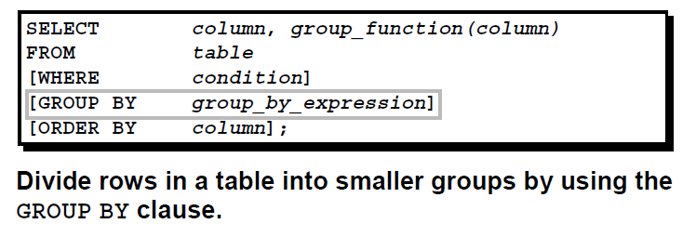
Aggregate Functions – Data Grouping
Aggregate functions are typically executed over a group of results.
The grouping of the result set based on one or more columns provided in GROUP BY condition.
All the columns present in the select clause, other than the aggregate function, should be a part of GROUP BY statement.
The grouped result can further be restricted by using HAVING clause.
SELECT EMPNAME, DEPTNO,
COUNT(*)
FROM EMPLOYEE
WHERE SAL > 25000
GROUP BY EMPNAME, DEPTNO
HAVING DEPTNO =10;

Slide 16

DML – Using functions in SELECT clause
Aggregate functions with Group By
COUNT
SELECT COUNT(*) FROM employees
GROUP BY dept_id;
SUM
SELECT SUM(SALARY) FROM employees GROUP BY dept_id;
MIN
SELECT MIN(SALARY) FROM employees GROUP BY dept_id;
MAX
SELECT MAX(SALARY) FROM employees GROUP BY dept_id;
AVG
SELECT AVG(SALARY) FROM employees
GROUP BY dept_id;

Slide 17
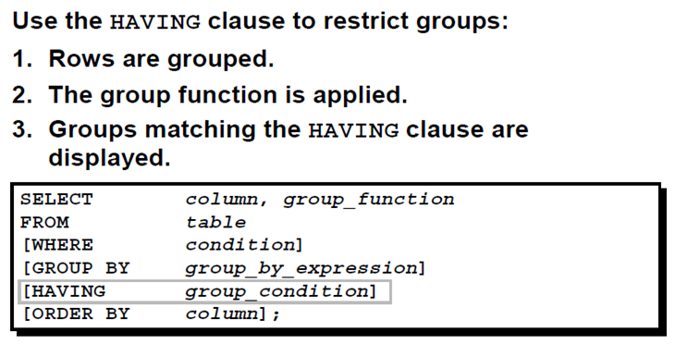
Restrict Groups – HAVING Clause
HAVING clause is used to restrict the groups based on condition provided in the clause.

Slide 18
Restrict Groups – HAVING Clause
Ex –
SELECT department_id, AVG(salary)
FROM employees
GROUP BY department_id
HAVING AVG(salary) > 8000;
In the above query,
First the group function AVG will be applied on groups formed by department_id.
Finally only those department_id will be selected where average salary > 8000.

Slide 19
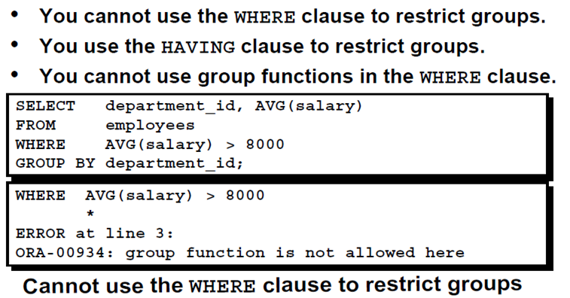
Restrict Groups

Slide 20
Restrict Groups
You can correct the previous slide error by using the HAVING clause to restrict groups.
SELECT department_id, AVG(salary)
FROM employees
GROUP BY department_id
HAVING AVG(salary) > 8000;

Slide 21
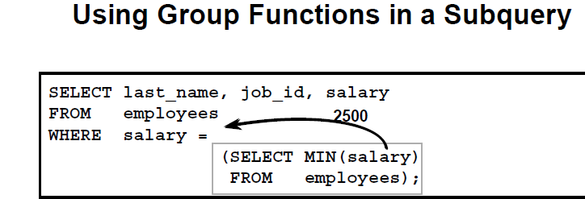
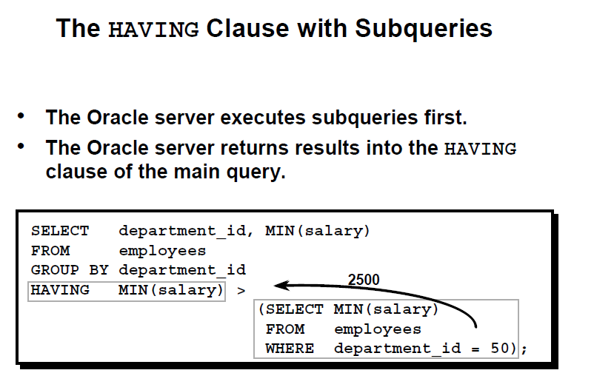
Group By and Subqueries

Slide 22
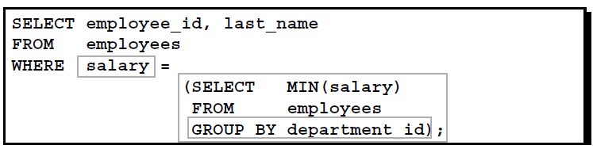
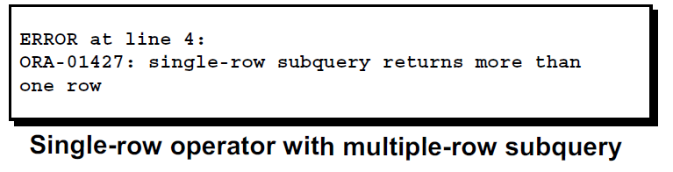
IN operator
The IN operator allows you to specify multiple values in a WHERE clause.
To correct the below error, change the = operator to IN.

Slide 23

Exercise # 4
List the count of employees in each department.
Display the highest, lowest, sum, and average salary of all employees
List the total expenditure of salaries in each department.
Find all the departments with more than 2 employees.
What is the difference between COUNT and SUM group function?
Can HAVING be used instead of WHERE?

Slide 24
SQL Joins

Slide 25

Join
The JOIN is used in SQL to query the data from two or more tables.
The data from the multiple tables is selected in SELECT clause. (<table>.<column> to avoid ambiguity in column names)
The tables are mostly (not always) joined based on PK-FK relationship.
The SELECT statement contains the column names from different tables.
The FROM clause specifies the different table names.
The WHERE clause specifies the condition to join the tables plus any other restricting condition.

Slide 26
Types of Join
Following are the different types of JOINs.
CARTESIAN Join
EQUI Join
OUTER Join
LEFT OUTER JOIN
RIGHT OUTER JOIN
FULL OUTER JOIN

Slide 27
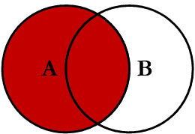
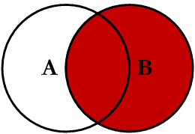
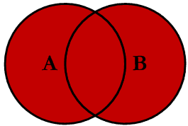
Outer Join Concept
The preserved row table (highlighted in red color) refers to the table that preserves rows when there is no match in the join operation.
The left table in a left outer join
The right table in a right outer join.
Both tables in a full outer join
All rows from the preserved row table will be returned, regardless of match with the second table.
The NULL-supplying table (with white background) supplies NULLs when there is an unmatched row.
In a full outer join, both tables can preserve rows and also can supply NULLs.
Left Outer Join
Right Outer Join
Full Outer Join

Slide 28
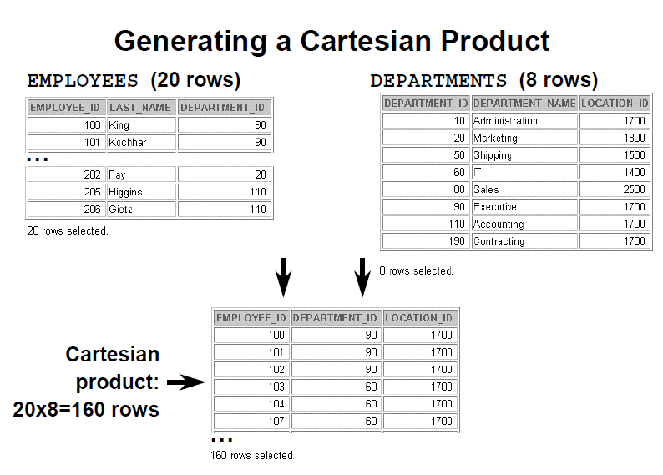
CARTESIAN (CROSS) Join
A Cartesian product is formed when:
– A join condition is omitted
– A join condition is invalid
– All rows in the first table are joined to all rows in the second table
To avoid a Cartesian product, always include a valid join condition in a WHERE clause.

Slide 29
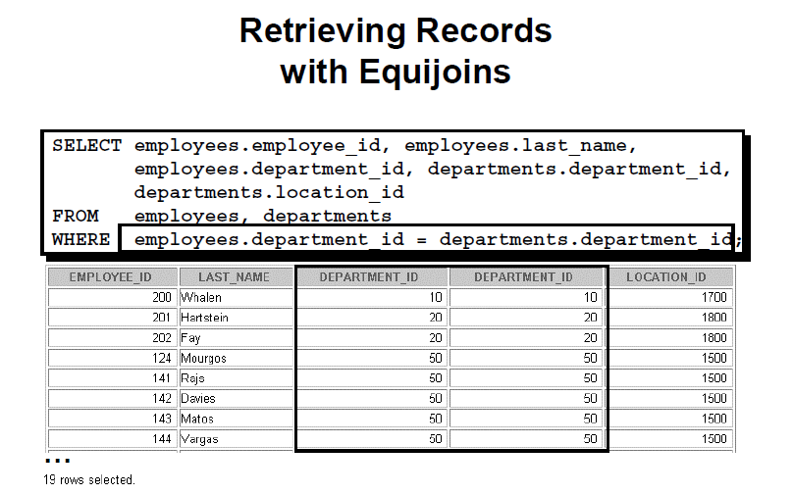
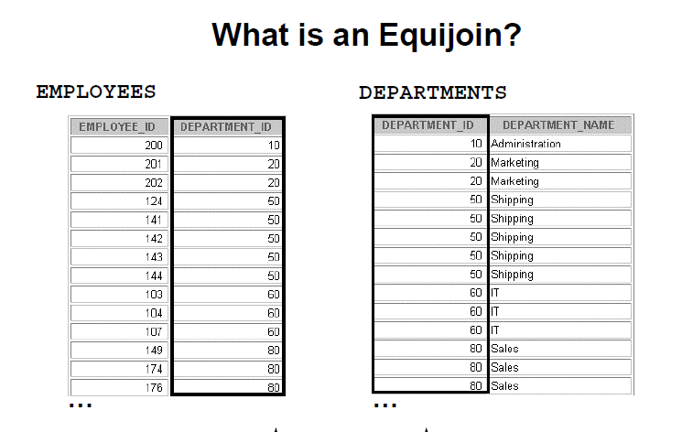
Equi Join
Join based on the common attributes.
Equijoins are also called simple joins or inner joins.
Only equality operator is used in the JOIN predicates.

Slide 30
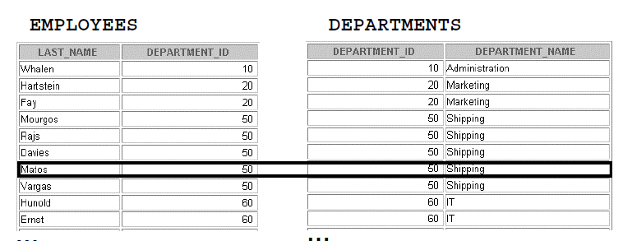
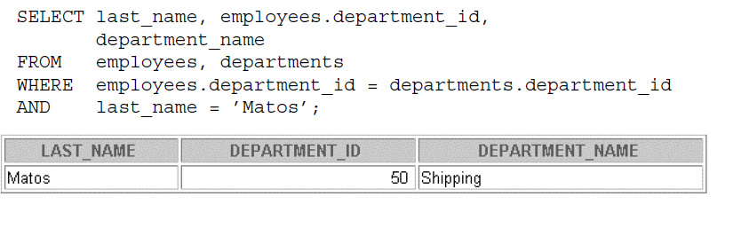
Additional Search Conditions Using the AND Operator

Slide 31
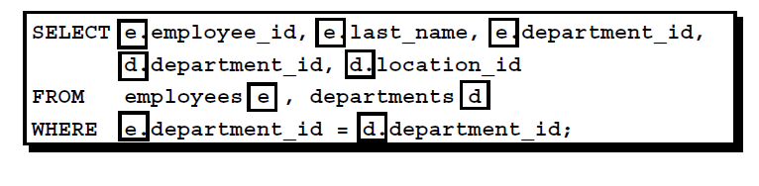
Table Aliases
Simplify queries by using table aliases.
Improve performance by using table prefixes.
Table aliases can be up to 30 characters in length, but shorter is better.
Table aliases should be meaningful.
The table alias is valid only for the current SELECT statement.

Slide 32
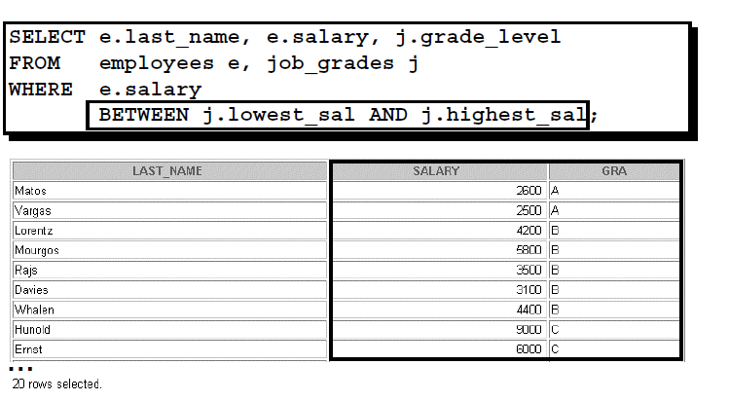
Non-Equijoins
Note: Other conditions, such as <= and >= can be used, but BETWEEN is the simplest. Remember to
specify the low value first and the high value last when using BETWEEN.
Table aliases have been specified in the slide example for performance reasons, not because of
possible ambiguity.

Slide 33
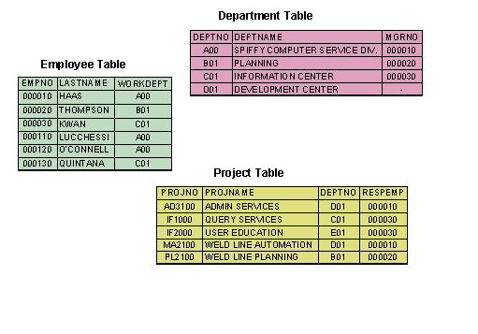
Example
Let us understand the outer join concepts with the help of following example tables:

Slide 34

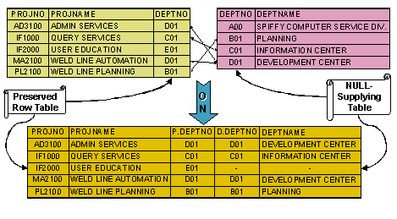
Left Outer Join
Left outer join returns the EQUI join result plus the rows that exist in the left table but have no matching values in the right table.
-- left join with ON-clause
SELECT PROJNO, PROJNAME,
P.DEPTNO, D.DEPTNO,
DEPTNAME
FROM PROJECT P LEFT OUTER JOIN
DEPARTMENT D
ON P.DEPTNO = D.DEPTNO;
-- left join with USING-clause
SELECT PROJNO, PROJNAME,
DEPTNO, DEPTNAME
FROM PROJECT P LEFT OUTER JOIN
DEPARTMENT D
USING(DEPTNO);
(The column part of USING clause cannot have qualifier)

Slide 35

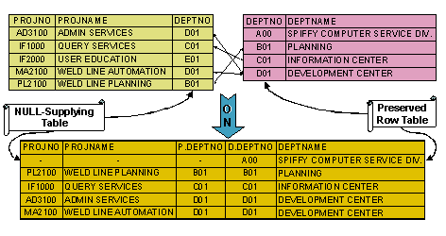
Right Outer Join
Right outer join returns the EQUI join result plus the rows that exist in the right table but have no matching values in the left table.
-- right join with ON-clause
SELECT PROJNO, PROJNAME,
P.DEPTNO, D.DEPTNO,
DEPTNAME
FROM PROJECT P RIGHT OUTER JOIN
DEPARTMENT D
ON P.DEPTNO = D.DEPTNO;
-- right join with USING-clause
SELECT PROJNO, PROJNAME,
DEPTNO, DEPTNAME
FROM PROJECT P RIGHT OUTER JOIN
DEPARTMENT D
USING(DEPTNO);

Slide 36

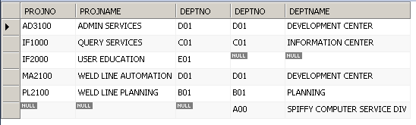
Full Outer Join
Full outer join returns the EQUI join result plus the unmatched rows from both the tables.
SELECT PROJNO, PROJNAME,
P.DEPTNO, D.DEPTNO,
DEPTNAME
FROM PROJECT P FULL OUTER JOIN
DEPARTMENT D
ON P.DEPTNO = D.DEPTNO;
Notes:
The above syntax does not work in the mysql db. Use the following sql in mysql-
SELECT PROJNO, PROJNAME, P.DEPTNO, D.DEPTNO, DEPTNAME
FROM PROJECT P LEFT OUTER JOIN
DEPARTMENT D
ON P.DEPTNO = D.DEPTNO;
UNION
SELECT PROJNO, PROJNAME, P.DEPTNO, D.DEPTNO, DEPTNAME
FROM PROJECT P RIGHT OUTER JOIN
DEPARTMENT D
ON P.DEPTNO = D.DEPTNO;

Slide 37
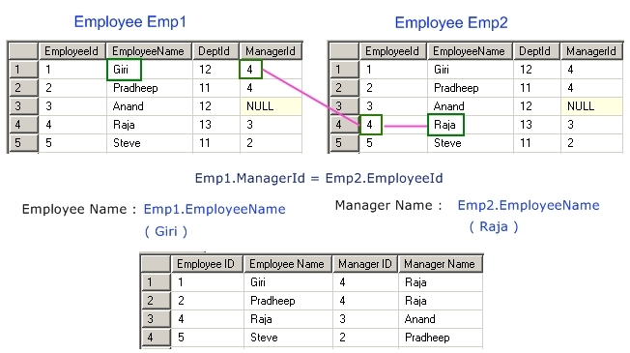
Self Join
In a self join, a table is joined with itself.
SELECT EMP1.EMPLOYEE_ID, EMP1.EMPLOYEE_NAME,
EMP1.MANAGER_ID, EMP2.EMPLOYEE_NAME
FROM EMPLOYEE EMP1,
EMPLOYEE EMP2
WHERE EMP1.MANAGER_ID = EMP2.EMPLOYEE_ID;

Slide 38
DML – UPDATE
Updating table using join
Example:
Update Aggregate marks of students in Student_Result table from Assessments table where the Exam_year is 2013.
UPDATE Student_Result s1 SET s1.Aggregate = (SELECT SUM(a1.Marks) FROM Assessments_2013 a1 WHERE a1.Rollno = s1.Rollno ) WHERE s1.Exam_Year = 2013;

Slide 39

Quiz Time
Can an Equi join have less than operator in the where condition?
No
Assume a Cartesian join between table A (with 5 rows) and table B (with 4 rows). How many rows should come up as output?
20
Is it possible to refer the same table thrice during self join?
Yes
In right outer join, is the null supplying table on the left side?
Yes
In a left outer join between table A (left table) and table B (right table), which is the preserved-row and NULL-supplying tables?
Table A = preserved-row
Table B = NULL supplying

Slide 40
Exercises
Write queries for the below using joins.
Note : Refer to the next slide for Employee and Department tables from Day 1.
Display the details of employees whose department names starts with “O”. (HINT – EQUI JOIN)
Display the details of all employees along with the department names. If employee does not have any dept, display “Not Assigned” in dept name column ( HINT – LEFT OUTER JOIN)
Display the dept id, dept name and the number of employees working in each department. ( HINT – RIGHT OUTER JOIN)

Slide 41
Employee and Department tables
TABLE NAME - EMPLOYEE
S. No. | Column Name | Description
1 | EMP_ID | Employee Id – Numeric, Max Length 5 - it’s the PK
2 | FIRST_NAME | First Name - Max Length 20 - Can't be null
3 | LAST_NAME | Last Name - Max Length 20
4 | BIRTH_DATE | Date
5 | EMP_ADDRESS | Address - Max Length 100 - Can't be null
6 | EMP_SALARY | Salary
7 | EMP_MGR_ID | Employee Id of the manager- Max Length 5
8 | DEPT_ID | Department Id of the employee
TABLE NAME - DEPARTMENT
S. No. | Column Name | Description
1 | DEPT_ID | Department id, its the PK-Max Length 2
2 | DEPT_NAME | Department Name - Max Length 20 - Can't be null

Slide 42
UNION

Slide 43
UNION
The UNION operator is used to combine the result-set of two or more SELECT statements.
Each SELECT statement within the UNION must have the same number of columns.
The columns must also have similar data types.
Also, the columns in each SELECT statement must be in the same order.
SQL UNION Syntax
SELECT column_name(s) FROM table1
UNION
SELECT column_name(s) FROM table2;
The UNION operator selects only distinct values by default. To allow duplicate values, use the ALL keyword with UNION
SELECT column_name(s) FROM table1
UNION ALL
SELECT column_name(s) FROM table2;
Notes:
Http://www.mysqltutorial.org/introduction-sql-views.aspx
By definition, a database view is a virtual or logical table which is composed of result set of a SELECT query. Because the database view is similar to the database table which consists of row and column so you can retrieve and update data on it in the same way with table. The database view is dynamic because it is not related to the physical schema. Database view is stored as view definition as SELECT statements. When the tables which are the source data of a view changes; the data in the view change also.
Views Advantages
Database views provide several advantages as follows:
Simplify complex query. A view is defined by an SQL statement with join on many underlying tables with complex business logic. The view now can be used to hides the complexity of underlying tables to the end users and external applications. Only simple SQL statement is used to work with view.
Limited access data to the specific users. You may don’t want a subset of sensitive data can be retrievable by all users (both human and applications). You can use view to expose what data to which user to limit the access.
Provide extra security. Security is vital parts of any relational database management system. Views provide extra security the database management system. View allows you to create only read-only view to expose read-only data to specific user. User can only retrieve data in read-only view but cannot update it.
Computed column. The database table should not have the calculated columns in it so you can use views to create computed columns. Suppose in the orderDetails table you have quantityOrder (number of ordered product) and priceEach (price per product item) columns but it does not have computed column to get the total cost for each line of order. In this case, you can create computed column call total which is equal to quantityOrder multiple with priceEach to storedthe computed result.
Backward compatibility. You have a center database and all applications use that database as their sources of data. One day you redesign the database to make it more clean and normalized. You then move the entire legacy data into the new database but you don’t want affect the legacy application in accessing it. In this case, you can use views to make them like the legacy database schema and return the same data so the legacy application won’t be affected.

Slide 44
SQL Index

Slide 45
SQL Index – Why do we need index ?
A database index is a data structure that improves the speed of data retrieval operations on a database table at the cost of additional writes and storage space to maintain the index data structure.
Indexes are used to quickly and efficiently locate data from tables without having to search every row in a database table every time a database table is accessed. .
An index helps speed up SELECT queries and WHERE clauses.
The whole point of having an index is to speed up search queries by essentially cutting down the number of records/rows in a table that need to be examined.
Indexes are used to speed up searches/queries.
Indexes speed up the querying process by providing swift access to rows in the data tables, similarly to the way a book’s index helps you find information quickly within that book.
SQL Index – How index improves performance ?
Because an index is basically a data structure that is used to store column values, looking up those values becomes much faster. And, if an index is using the most commonly used data structure type – a B- tree – then the data structure is also sorted. Having the column values be sorted can be a major performance enhancement. Let’s say that we create a B- tree index on the Employee_Name column This means that when we search for employees named “Jesus” using the SQL we showed earlier, then the entire Employee table does not have to be searched to find employees named “Jesus”. Instead, the database will use the index to find employees named Jesus, because the index will presumably be sorted alphabetically by the Employee’s name. And, because it is sorted, it means searching for a name is a lot faster because all names starting with a “J” will be right next to each other in the index! It’s also important to note that the index also stores pointers to the table row so that other column values can be retrieved.
Indexes are typically the primary means of improving SQL query performance. They allow you to retrieve the required data quickly.

Slide 46


SQL Index
Indexes are created on columns which are accessed frequently, to retrieve the rows quickly.
Indexes can be created on a single column or a group of columns.
Any column in CREATE TABLE statement declared as PRIMARY KEY, KEY, UNIQUE or INDEX will be indexed automatically.
When a index is created, it first sorts the data and then it assigns a ROWID for each row.
Syntax to create Index:
OR
UNIQUE means all values in the index must be distinct. Duplicated NULL is allowed.
FULLTEXT index accepted columns which have data type is CHAR,VARCHAR or TEXT.
SPATIAL index supports spatial column value and must not be NULL like GEOMETRY, POINT, LINESTRING etc.

Slide 47
SQL Index – Advantages / Disadvantages of using Clustered / Non-clustered index ?
 | CLUSTERED | NON-CLUSTERED
Advantages | Fast to return large range of data Fast for presorted results | Wide keys do not reflect on other indexes Frequently updated key columns do not reflect on other indexes Can be assigned on different FileGroup Many non-clustered indexes per table Smaller size than clustered indexes due to column subsets
Disadvantages | Frequently updated key columns reflect on non-clustered indexes Wide keys increase the size of the non-clustered indexes Only one clustered index per table | Generally slower than clustered indexes due to bookmark lookup (except for covering indexes). Not recommended for returning large data sets (except for covering indexes).

Slide 48
Understanding index types in single table
Step 1 : Create 2 tables
Create 2 tables. Note that there are no constraints at present on these tables. We will add the constraints one by one :
CREATE TABLE Student(StudId smallint, StudName varchar(50), Class tinyint);
CREATE TABLE TotalMarks(StudentId smallint, TotalMarks smallint);
Step 2 : Add Primary Key constraint
We will mark the StudId column of the Student table as primary key.
ALTER TABLE Student
ADD PRIMARY KEY (StudId )
Step 3 : Clustered Index
The primary key created for the StudId column will create a clustered index for the Studid column. A table can have only one clustered index on it.

Slide 49
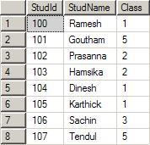
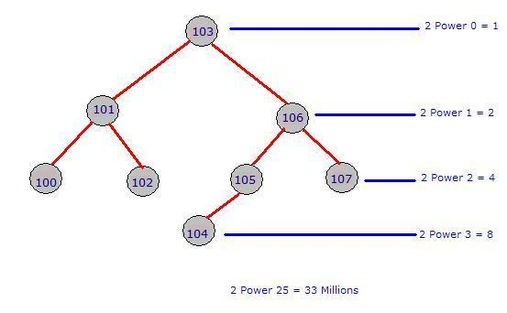
Understanding index types in single table contd…
Let us assume that you had entered the following data in the table student:
The index will form the below specified binary tree :

Slide 50
Understanding index types in single table contd…
let us assume that we had written a query like below:
Select * from student where studid = 103;
Select * from student where studid = 107;
Execution without index will return value for the first query after third comparison. Execution without index will return value for the second query at eights comparison.
Execution of first query with index will return value at first comparison. Execution of second query with index will return the value at the third comparison. Look below:
Compare 107 vs 103 : Move to right node
Compare 107 vs 106 : Move to right node
Compare 107 vs 107 : Matched, return the record
Step 4 : Non clustered index
Depending on the type of DB you are using, you need to right click on table and select the columns you want to add to the non clustered index.
A table can have more than one Non-Clustered index. But, it should have only one clustered index that works based on the Binary tree concept. Non-Clustered column always depends on the Clustered column on the database.

Slide 51
Understanding index types in single table contd…
This can be easily explained with the concept of a book and its index page at the end. Let us assume that you are going to a bookshop and found a big 1500 pages of Java book. You search for a topic say “regular Expressions” :
You went to the Index page (it has total 25 pages). It is already sorted and hence you easily picked up Regular Expression that comes on page Number 17.
Next, you noted down the number displayed next to it which is 407, 816, 1200-1220.
Your first target is Page 407. You opened a page in the middle, the page is greater than 500.
Then you moved to a somewhat lower page. But it still reads 310.
Then you moved to a higher page. You are very lucky you exactly got page 407.
That’s all, you started exploring what is written about Regular expression on that page, keeping in mind that you need to find page 816 also.
In the above scenario, the Index page is Non-Clustered index and the page numbers are clustered index arranged in a binary tree. See how you came to the page 407 very quickly. Your mind actually traversed the binary tree way left and right to reach the page 407 quickly.

Slide 52
Understanding index types in joins
Put a non-clustered index on the columns that will be used in JOIN conditions - the foreign key columns.
This helps in several ways - JOIN operations will be faster, and enforcing the FK constraint (checking whether there's a child row attached when attempting to delete the parent row) will also benefit from those indices.
Then check to see how your system performs. If it performs below your expectations - carefully add one index and see if the overall system performance improves. If not: remove the index again. Repeat over until you're happy with the performance.
Columns used in WHERE or ORDER BY clauses are the prime candidates for those indices - but don't over-index! That's even worse than having no indices at all.
Small table joined to big table ==> go for nested loops & focus your clustered index on the "filter" field in the small table & the join field in the big table.
Big table joined to big table => go for hash/merge join and put the clustered index on the matching field on both sides
Multi-field indexes usually only a good idea when they are "covering", this means all the fields you query are included in the index. (or are included with the include() clause)

Slide 53
Types of index
Two types of SQL index namely,
Implicit Indexes:
They are created when a column is explicity defined with PRIMARY KEY, UNIQUE KEY Constraint.
Explicit Indexes:
They are created using the "create index..." or “alter…” command.
NOTE: 1) Even though SQL indexes are created to access the rows in the table quickly, they slow down DML operations like INSERT, UPDATE, DELETE on the table, because the indexes and tables both are updated along when a DML operation is performed. So use indexes only on columns which are used to search the table frequently. 2) It is not required to create indexes on table which have less data. 3) The maximum number of columns per index is 16.

Slide 54

Advantages of sub query over join.
Subqueries structure a complex query into isolated parts so that a complex query can be broken down into a series of logical steps for easy understanding and code maintenance.
Subqueries allow you to use the results of another query in the outer query.
In some cases, subqueries can replace complex joins and unions and subqueries are easier to understand.
Subqueries are advantageous because they structure the query to isolate each part of the statement, perform the same operation that would ordinarily require complex joins and unions and are easier to read.
Subqueries are advantageous over joins when you have to calculate an aggregate value on-the-fly and use it in the outer query for comparison.
Get the employee numbers and enter dates of all employees with enter dates
This problem cannot be solved easily with a join, because you would have to write the aggregate function in the WHERE clause, which is not allowed. (You can solve the problem using two separate queries in relation to the works_on table.)

Slide 55
When should we use sub-query and when should we use join?
Use a join or a subquery any time that you reference information from multiple tables. Joins and subqueries are often used together in the same query. In many cases, you can solve a data retrieval problem by using a join, a subquery, or both. Here are some guidelines for using joins and queries.
If your report needs data that is from more than one table, then you must perform a join. Whenever multiple tables (or views) are listed in the FROM clause, those tables become joined.
If you need to combine related information from different rows within a table, then you can join the table with itself.
Use subqueries when the result that you want requires more than one query and each subquery provides a subset of the table involved in the query.
If a membership question is asked, then a subquery is usually used. If the query requires a NOT EXISTS condition, then you must use a subquery because NOT EXISTS operates only in a subquery; the same principle holds true for the EXISTS condition.
Many queries can be formulated as joins or subqueries. Although the PROC SQL query optimizer changes some subqueries to joins, a join is generally more efficient to process.

Slide 56
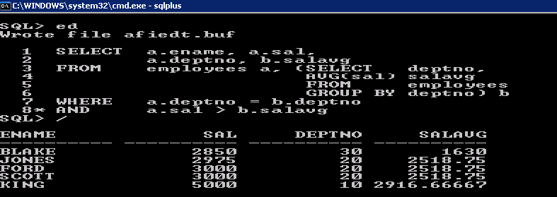
Correlated Sub queries
Q: Find all employees who earn more than the average salary in their department.

Slide 57
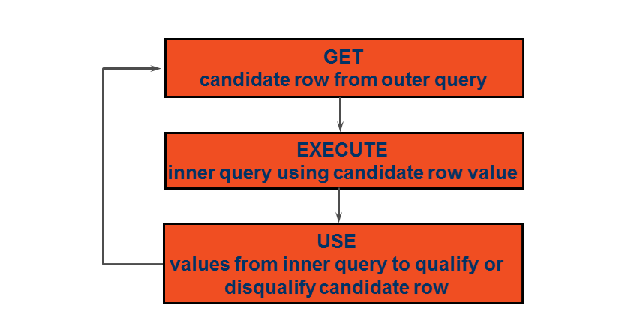
Correlated Subqueries
Correlated subqueries are used for row-by-row processing. Each subquery is executed once for every row of the outer query.

Slide 58
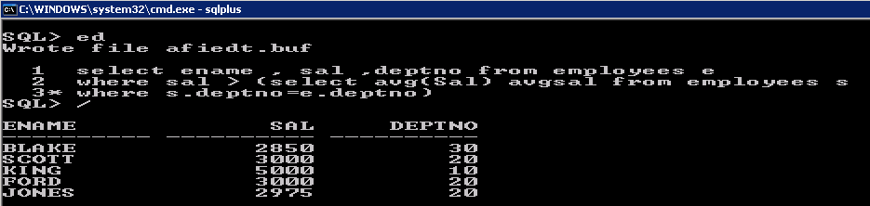
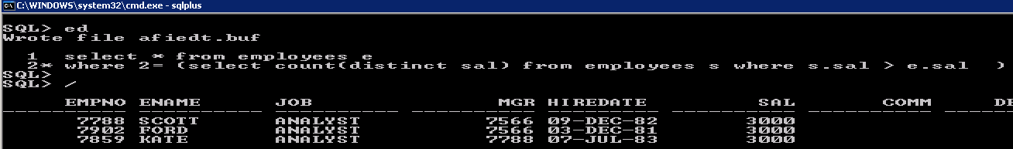
Correlated Subqueries

Slide 59
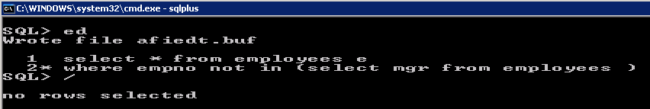
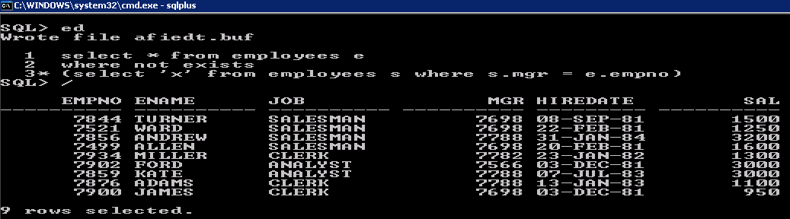
EXISTS and NOT EXISTS

Slide 60
With Clause
Write a query to display the department name and total salaries for those departments whose total salary is greater than the average salary across departments.
Using the WITH clause, you can use the same query block in a SELECT statement when it occurs more than once within a complex query.
The WITH clause retrieves the results of a query block and stores it in the user's temporary table space.
The WITH clause improves performance

Slide 61
WITH Clause –Example
WITH dept_costs AS (
SELECT d.department_name, SUM(e.salary) AS dept_total
FROM employees e, departments d
WHERE e.department_id = d.department_id
GROUP BY d.department_name),
avg_cost AS (
SELECT SUM(dept_total)/COUNT(*) AS dept_avg
FROM dept_costs)
SELECT *
FROM dept_costs
WHERE dept_total >
(SELECT dept_avg
FROM avg_cost)
ORDER BY department_name;

Slide 62
How to analyze query , How to create query plan and how to use it in tuning
The SQL Server Database Engine can display how it navigates tables and uses indexes to access or process the data for a query or other DML statement, such as an update. This is a display of an execution plan. To analyze a slow-running query, it is useful to examine the query execution plan to determine what is causing the problem.
SQL Server generates an execution plan for each query. The plan describes an algorithm that will lead to a desired result. A query plan (or query execution plan) is an ordered set of steps used to access data in a SQL relational database management system.
We should also keep in mind how execution plans are generated. To reach maximal query execution speed, query optimizer (separate component of the SQL Server core) always attempts to generate a plan with the sequence of actions that consumes minimum server resources.
When evaluating any execution plan, the query optimizer takes into account multiple factors: involved database objects, conditions of joining them, returned columns list, indexes presence, availability of indexes and actual statistics, etc..
When it comes time to analyze the performance of a specific query, one of the best methods is to view the query execution plan. A query execution plan outlines how the SQL Server query optimizer actually ran (or will run) a specific query. This information if very valuable when it comes time to find out why a specific query is running slow.
Many queries can be formulated as joins or subqueries. Although the PROC SQL query optimizer changes some subqueries to joins, a join is generally more efficient to process.
A query plan is a set of steps that the database management system executes in order to complete the query. The reason we have query plans is that the SQL you write may declare your intentions, but it does not tell SQL the exact logic flow to use. The query optimizer determines that. The result of that is the query plan. In SQL Server a query plan is called an execution plan.
Execution plans can tell you how a query will be executed, or how a query was executed. They are, therefore, the DBA’s primary means of troubleshooting a poorly performing query. Rather than guess at why a given query is performing thousands of scans, putting your I/O through the roof, you can use the execution plan to identify the exact piece of SQL code that is causing the problem.

Slide 63
How to analyze query , How to create query plan and how to use it in tuning
There are several different ways to view a query’s execution plan. They include:
From within Query Analyzer is an option called “Show Execution Plan” (located on the Query drop-down menu). If you turn this option on, then whenever you run a query in Query Analyzer, you will get a query execution plan (in graphical format) displayed in a separate window.
If you want to see an execution plan, but you don’t want to run the query, you can choose the option “Display Estimated Execution Plan” (located on the Query drop-down menu). When you select this option, immediately an execution plan (in graphical format) will appear. The difference between these two (if any) is accountable to the fact that when a query is really run (not simulated, as in this option), current operations of the server are also considered. In most cases, plans created by either method will produce similar results.
When you create a SQL Server Profiler trace, one of the events you can collect is called: MISC: Execution Plan. This information (in text form) shows the execution plan used by the query optimizer to execute the query.
From within Query Analyzer, you can run the command SET SHOWPLAN_TEXT ON. Once you run this command, any query you execute in this Query Analyzer sessions will not be run, but a text-based version of the query plan will be displayed. If the query you are running uses temp tables, then you will have to run the command, SET STATISTICS PROFILE ON before running the query.

Slide 64
How to analyze query , How to create query plan and how to use it in tuning
Database Tuning:
Reviewing the query plan can present opportunities for new indexes or changes to existing indexes. It can also show that the database is not properly taking advantage of existing indexes.
Query Tuning:
A query optimizer will not always choose the most efficient query plan for a given query. In some databases the query plan can be reviewed, problems found, and then the query optimizer gives hints on how to improve it. In other databases alternatives to express the same query (other queries that return the same results) can be tried. Some query tools can generate embedded hints in the query, for use by the optimizer.
Some databases - like Oracle - provide a plan table for query tuning. This plan table will return the cost and time for executing a query. Oracle offers two optimization approaches:
CBO or Cost Based Optimization
RBO or Rule Based Optimization
RBO is slowly being deprecated. For CBO to be used, all the tables referenced by the query must be analyzed. To analyze a table, a DBA can launch code from the DBMS_STATS package.
Other tools for query optimization include:
SQL Trace
Oracle Trace
TKPROF

Slide 65
Isolation Levels and Impact On Performance
Transactions specify an isolation level that defines the degree to which one transaction must be isolated from resource or data modifications made by other transactions.
Isolation is typically defined at database level as a property that defines how/when the changes made by one operation become visible to other.
Isolation is one of the ACID (Atomicity, Consistency, Isolation, Durability) properties.
The isolation level that is associated with an application process determines the degree to which the data that is being accessed by that process is locked or isolated from other concurrently executing processes. The isolation level is in effect for the duration of a unit of work. The isolation level of an application process therefore specifies:
The degree to which rows that are read or updated by the application are available to other concurrently executing application processes
The degree to which the update activity of other concurrently executing application processes can affect the application
In database systems, isolation determines how transaction integrity is visible to other users and systems. For example, when a user is creating a Purchase Order and has created the header, but not the Purchase Order lines, is the header available for other systems/users, carrying out concurrent operations (such as a report on Purchase Orders), to see?.
A lower isolation level increases the ability of many users to access data at the same time, but increases the number of concurrency effects (such as dirty reads or lost updates) users might encounter. Conversely, a higher isolation level reduces the types of concurrency effects that users may encounter, but requires more system resources and increases the chances that one transaction will block another.
To set the isolation level, you can issue a SET TRANSACTION ISOLATION LEVEL statement after you connect to SQL Server. The isolation level will apply to the rest of that session, unless you explicitly change the level again.

Slide 66
Isolation Levels and Impact On Performance
There are four isolation levels, as follows.
READ UNCOMMITTED: UserA will see the change made by UserB. This isolation level is called dirty reads, which means that read data is not consistent with other parts of the table or the query, and may not yet have been committed. This isolation level ensures the quickest performance, as data is read directly from the table’s blocks with no further processing, verifications or any other validation. The process is quick and the data is as dirty as it can get.
READ COMMITTED: UserA will not see the change made by UserB. This is because in the READ COMMITTED isolation level, the rows returned by a query are the rows that were committed when the query was started. The change made by UserB was not present when the query started, and therefore will not be included in the query result.
REPEATABLE READ: UserA will not see the change made by UserB. This is because in the REPEATABLE READ isolation level, the rows returned by a query are the rows that were committed when the transaction was started. The change made by UserB was not present when the transaction was started, and therefore will not be included in the query result.
This means that “All consistent reads within the same transaction read the snapshot established by the first read” (from MySQL documentation. See http://dev.mysql.com/doc/refman/5.1/en/innodb-consistent-read.html).
SERIALIZABLE: This isolation level specifies that all transactions occur in a completely isolated fashion, meaning as if all transactions in the system were executed serially, one after the other. The DBMS can execute two or more transactions at the same time only if the illusion of serial execution can be maintained.

Slide 67

Questions

Slide 68
THANK YOU

